Slide 1
Quality AI Requires Quality Data
Lower Risk, Improve Results, Avoid Embarrassment!
Edward Pollack
Microsoft Data Platform MVP

Slide 3


Community Support
Toronto Data Professionals Community (TDPC), one of the largest data professional's community in Toronto, host monthly event which offers interactive learning built by community and guided by trusted data experts.
TDPC Event Partners

Slide 4
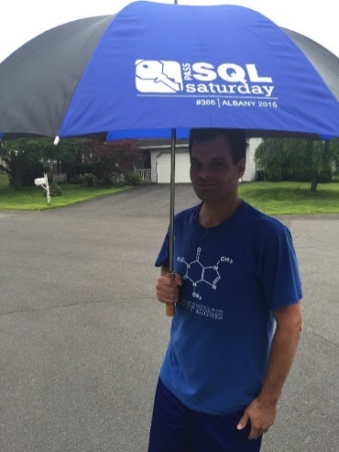






Ed Pollack
Microsoft Data Platform MVP
Published author of:
Dynamic SQL: Applications, Performance, and Security, 2nd Edition
Analytics Optimization with Columnstore Indexes in SQL Server
Expert Performance Indexing in SQL Server, 4th Edition
Published in Expert T-SQL Functions in SQL Server, 3rd Edition
Author on Simple Talk.
Organizes:
SQL Saturday Albany 2024
SQL Saturday New York City (Tentatively: May 10^{th)}
Future Data Driven
Capital Area SQL Server User Group
Speaker at many data events
Find me on: LinkedIn

Slide 5
Agenda
Why does data quality matter?
Best practices to improve data quality.
What are frequent data mistakes made in AI?
Bring-it-all-together!

Slide 6
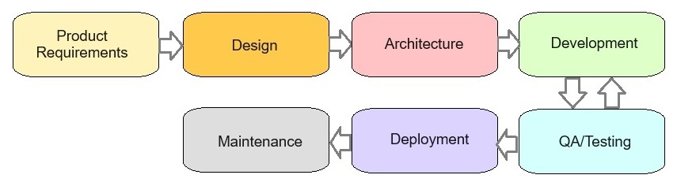
Software Development Life Cycle (Sometimes)

Slide 7
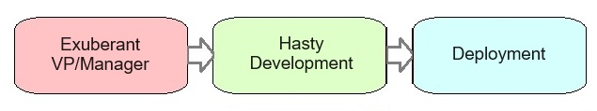
AI Development Life Cycle (Sometimes)

Slide 8
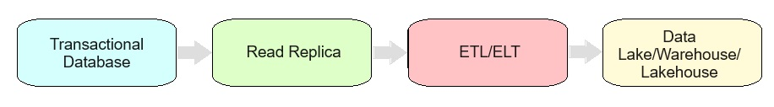
Challenges of Data & AI
Data grows and evolves over time
Data may be copied/moved/transformed many times prior to ML/AI
Existing data quality is inherited by downstream processes
AI processes are often quite authoritative

Slide 9
How can we
prevent bad data?

Slide 10

Validating OLTP/App/Edge Data
This is bad application data!
Its data journey begins here.
Bad data from here will persist forever.

Slide 11
Validating OLTP/App/Edge Data
Application constraints/restrictions
Routine validation processes
Unique indexes/constraints
Foreign keys
Check constraints
Many of the above!

Slide 12
Validation (OLAP/Report/Analytic Data)
Validate data after movement:
Data size (row count, byte count, etc…)
Validate values (uniqueness, NULL? invalid values?)
Missing data?
Duplicate data?
Edge-cases?
Validate BEFORE training models/RAG!

Slide 13

Validation (Releases)
When code changes, validate impacted data
Back up any data-to-be-modified!
Without QA, existing data/validation may become incomplete/incorrect.

Slide 14
Names/Data Types Matter!
Poorly named data elements can trick AI into making bad decisions.
Poorly typed data can confuse AI.
Check with original data source, if needed.
Integer named “Invoice”? What is it?
Datetime named “EntryTime”? Is it date/time or time?
Column named “IsDeleted”: Should AI use this data?

Slide 15
Note: Training Data vs. RAG Data
Both are important for a scalable AI system
Both can experience bad data
Bad training data = misbehaving model
Bad RAG data = incorrect responses

Slide 16
How do we cheat bad data?

Slide 17
Prompt Engineering
Improves AI interactions and output
Delineates purpose
Ensures relevance
Refines inputs/outputs
Cannot prompt your way out of bad data!

Slide 18
RAG
Train model on one data set, use current/updated/relevant data for responses.
Cannot be used to “fix” bad training
Fixing/updating bad RAG data is not hard.

Slide 19
Semantic Search
Breaks data into chunks, creating mathematical associations of similarity.
Bad data will create bad associations that are hard to find and fix.
Vectorization detail can be used, if needed, to reverse engineer bad results.

Slide 20
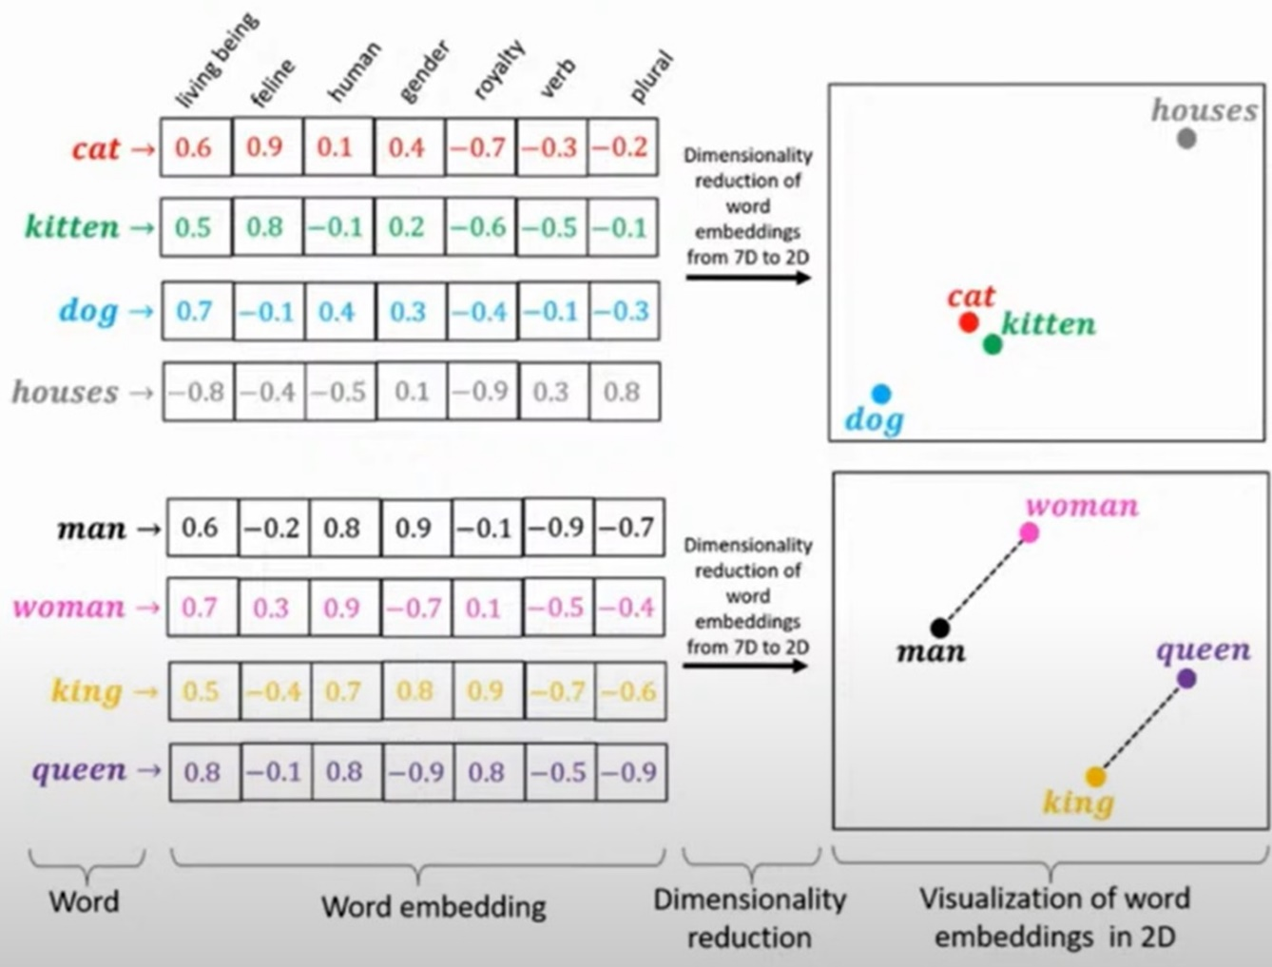
Semantic Search

Slide 21

Fine-Tuning
Allows a model to be tailored to a more specific use-case.
Requires significant time/effort to implement.
Is NOT a solution to bad data anywhere else.

Slide 22
Synthetic Data
Artificially-generated data
Mimics real-world data
Same mathematical properties
Different information
Can remove PII/protected data
Hard to generate without bias/replication/bad data
Need to prove that new data is valid AND unique.
Cannot dilute bad data with good synthetic data
Must be validated.

Slide 23
Unlearning Data Can Harm Models
Unlearning involves forcing a model to forget specific information.
PII
Bad data
Copyrighted material
Current unlearning methods are not mature enough to manage data loss without retraining.

Slide 24
Intelligent Capture
Using existing unstructured data:
Reads
Interprets
Generates Insights
Writes new data
Bad data is magnified via this process!
Test carefully before implementing

Slide 25
Feedback Loops
AI can create/modify insights, data, responses, and content
Beware this new data becoming part of existing data
Is this intentional!?
Feedback loops can amplify some results or diminish others.
Use caution when adding new data to existing data sets!

Slide 26

Conclusion
Bad data is most easily resolved at its source.
AI model manipulation is not a substitute for good data.
Carefully test models and ensure that invalid responses are identified and resolved by finding their origin.

Slide 27
Questions? Thank You!
Find me here:
Ed Pollack | LinkedIn
Edward Pollack | Most Valuable Professionals
https://sessionize.com/edward-pollack/
Find my content here:
EdwardPollack (Ed Pollack) (github.com)
Edward Pollack, Author at Simple Talk (red-gate.com)
Ed Pollack, Author at SQL Shack - articles about database auditing, server performance, data recovery, and more

